Slide 1
Measures of Dispersion
Md. Ismail Hossain Riday

Slide 2
Dispersion
In previous chapter, we learned how to summarize a raw data set using a single value that indicates the center of the distribution.
It gives only partial information of the data set.

Slide 3
Dispersion
For example, Record the examination results of two students
Student A: 50, 49, 51, 50
Student B: 100, 100, 0, 0

Slide 4
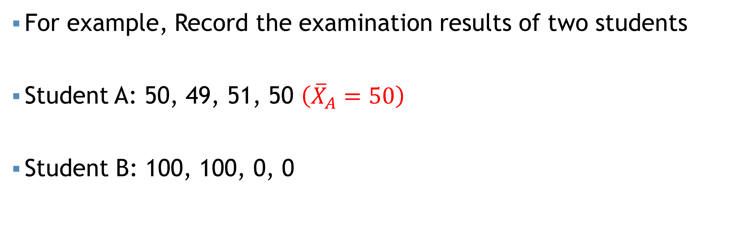
Dispersion
For example, Record the examination results of two students
Student A: 50, 49, 51, 50 $\left({\overline{X}}_{A}=50\right)$
Student B: 100, 100, 0, 0

Slide 5
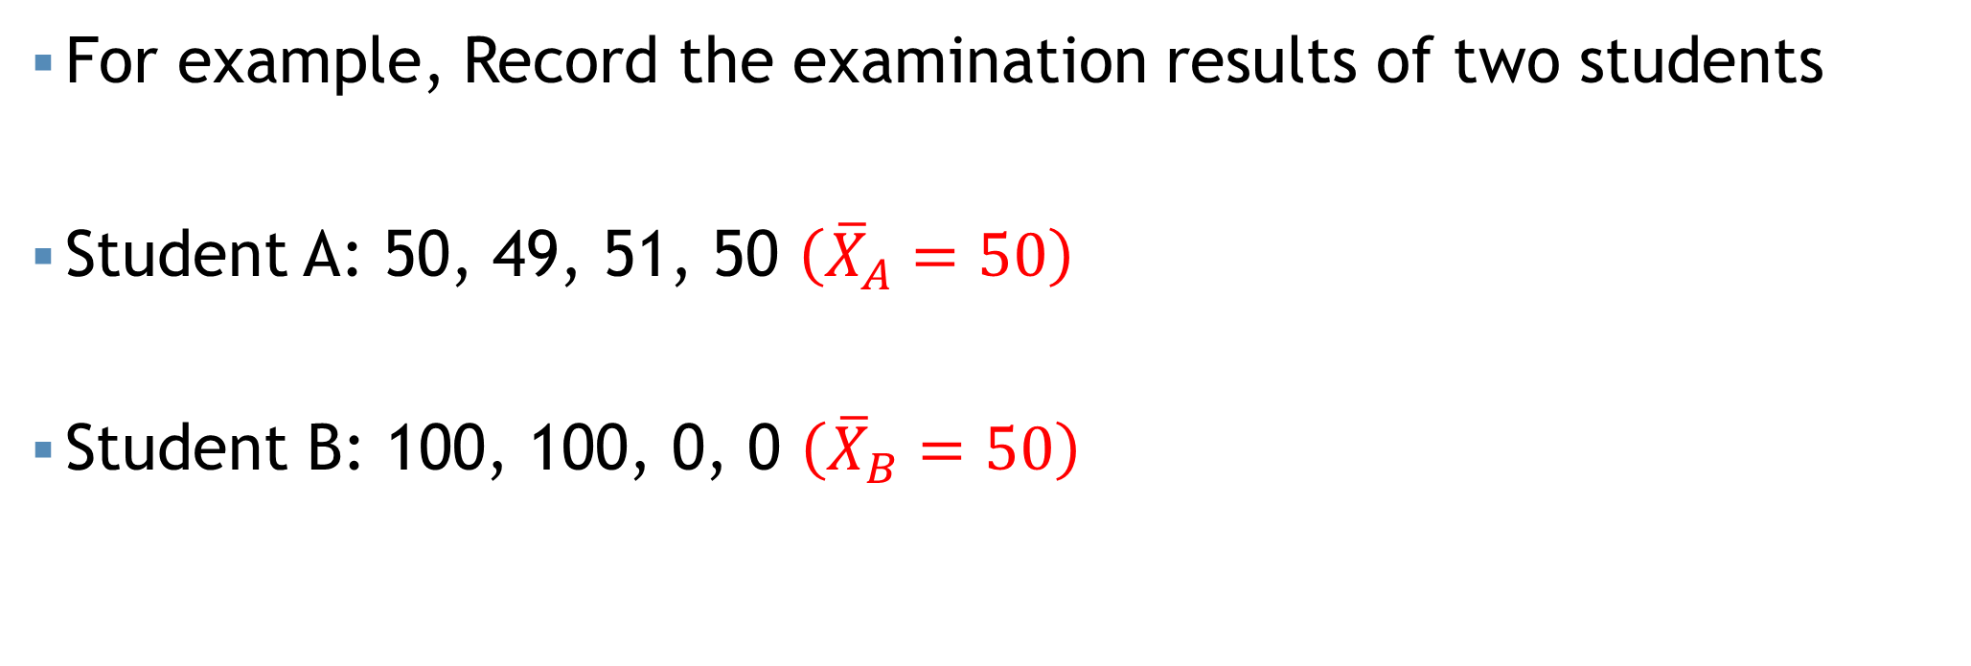
Dispersion
For example, Record the examination results of two students
Student A: 50, 49, 51, 50 $\left({\overline{X}}_{A}=50\right)$
Student B: 100, 100, 0, 0 $\left({\overline{X}}_{B}=50\right)$

Slide 6
Dispersion
For example, Record the examination results of two students
Student A: 50, 49, 51, 50 $\left({\overline{X}}_{A}=50\right)$
Student B: 100, 100, 0, 0 $\left({\overline{X}}_{B}=50\right)$
On average both students are equal in getting final exam score
So it is also important to describe “How much the observation vary from one to another
Dispersion/ Variation

Slide 7
Measures of Dispersion
Dispersion may describe how much the observation vary from one to another.
Descriptive measures that indicate the amount of variation in a data set are called measures of dispersion.

Slide 8
Why do we need?
To determine the reliability of an average
To compare the variability of two or more data sets.

Slide 9
Types of Measures of Dispersion
Two types of measures of dispersion
Absolute measure
Relative measure

Slide 10
Absolute measures
Only measure the inherent variation of a data set

Slide 11
Absolute measures
Only measure the inherent variation of a data set
Important absolute measures are-
Range
Mean Deviation
Variance
Quartile Deviation

Slide 12

Range
$Range=Highest value−Lowest value$

Slide 13
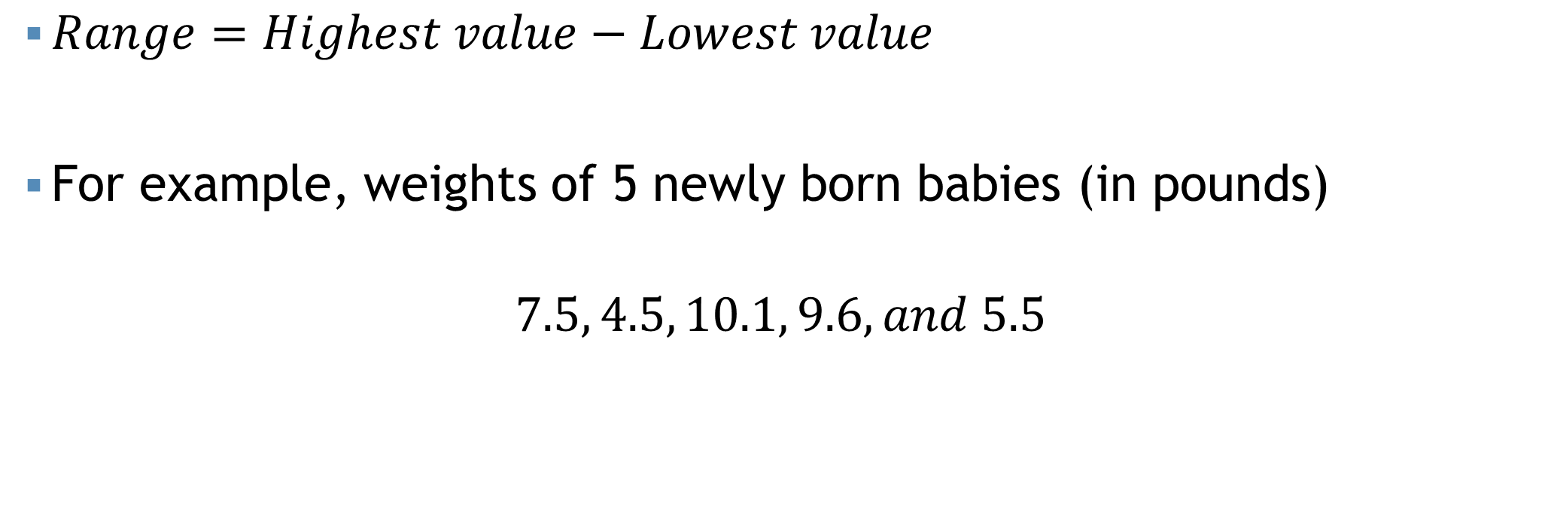
Range
$Range=Highest value−Lowest value$
For example, weights of 5 newly born babies (in pounds)
$$7.5, 4.5, 10.1, 9.6, and 5.5$$

Slide 14
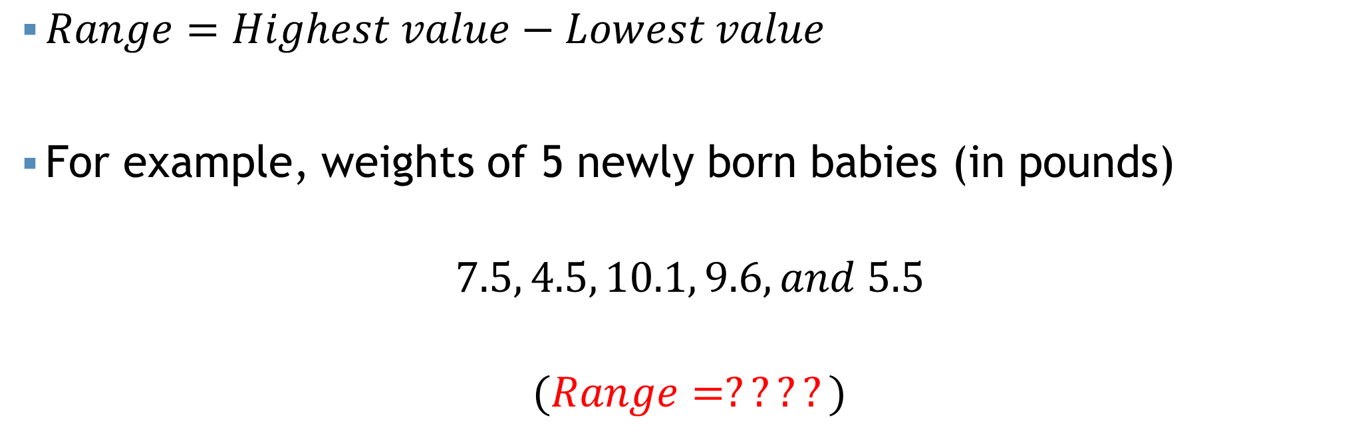
Range
$Range=Highest value−Lowest value$
For example, weights of 5 newly born babies (in pounds)
$$7.5, 4.5, 10.1, 9.6, and 5.5$$
$$(Range=????)$$

Slide 15
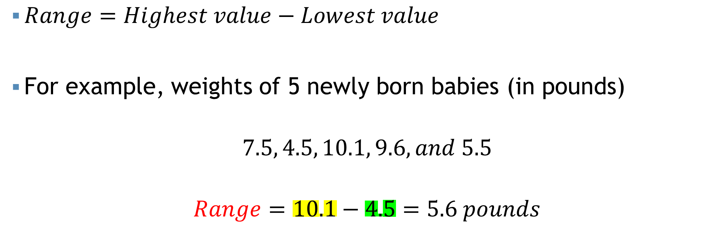
Range
$Range=Highest value−Lowest value$
For example, weights of 5 newly born babies (in pounds)
$$7.5, 4.5, 10.1, 9.6, and 5.5$$
$$Range=10.1−4.5=5.6 pounds$$

Slide 16
Range
Data set A: 2, 4, 9, 9, 10, 14
Data set B: 2, 7, 9, 9, 7, 14
Mean=8
Median=9
Range=12

Slide 17
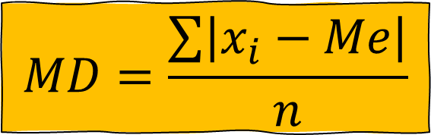
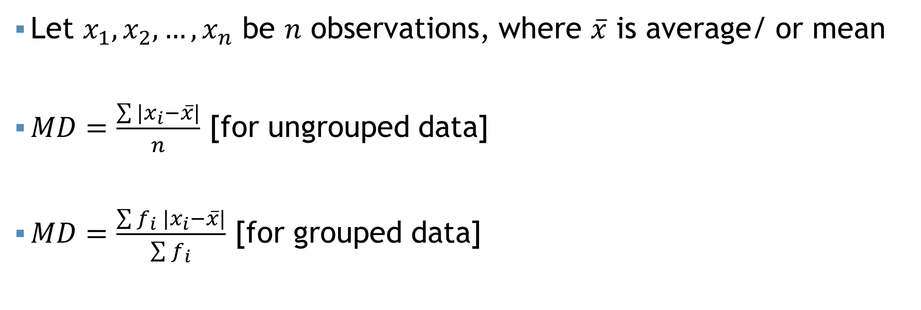
Mean Deviation
$$MD=\frac{\sum{\left|x_{i}−Me\right|}}{n}$$
Let $x_{1},x_{2},…,x_{n}$ be $n$ observations, where $\overline{x}$ is average/ or mean
$MD=\frac{\sum{|x_{i}−\overline{x}|}}{n}$ [for ungrouped data]
$MD=\frac{\sum{f_{i} |x_{i}−\overline{x}|}}{\sum{f_{i}}}$ [for grouped data]

Slide 18

Mean Deviation
For example, $x=1,2,4,5$.

Slide 19
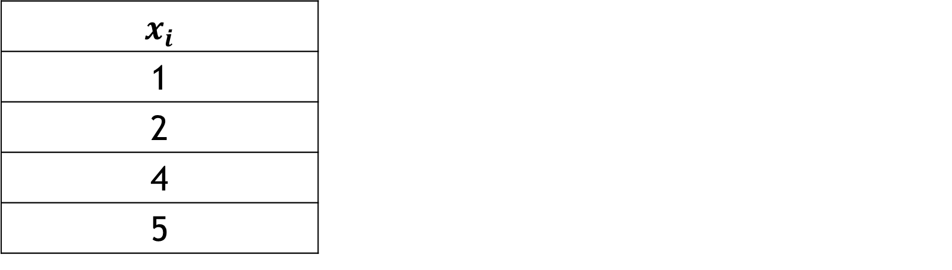

Mean Deviation
For example, $x=1,2,4,5$. Calculate the mean deviation.
$$x_{i}$$ | $$\overline{x}$$ | $$|x_{i}−\overline{x}|$$
1 | $$\frac{\sum{x_{i}}}{n}=3$$ | 2
2 |  | 1
4 |  | 1
5 |  | 2

Slide 20
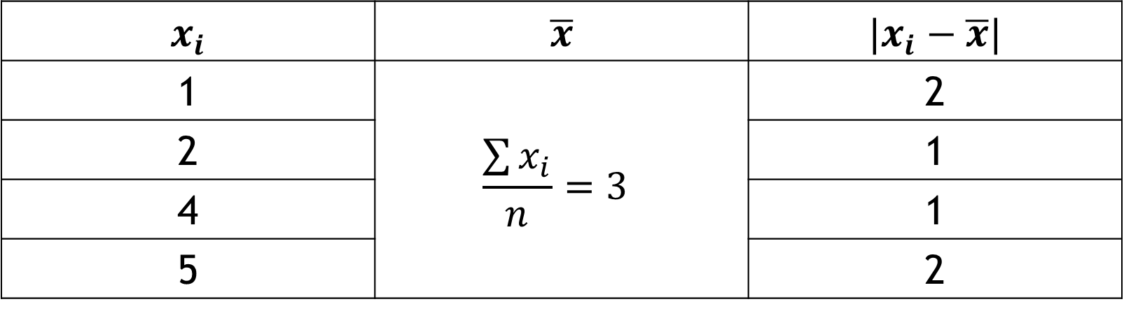
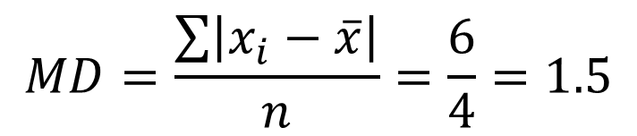
Mean Deviation
For example, $x=1,2,4,5$. Calculate the mean deviation.
$$x_{i}$$ | $$\overline{x}$$ | $$|x_{i}−\overline{x}|$$
1 | $$\frac{\sum{x_{i}}}{n}=3$$ | 2
2 |  | 1
4 |  | 1
5 |  | 2
$$MD=\frac{\sum{\left|x_{i}−\overline{x}\right|}}{n}=\frac{6}{4}=1.5$$

Slide 21

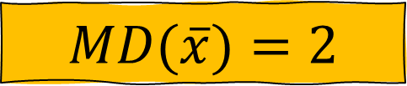
Mean Deviation
Following are the heights (cm) of the players of a team
142, 143, 146, 146, 148
The heights of the players vary from the mean height on average by 2 cm
$$MD(\overline{x})=2$$
The heights of the players vary from the median height on average by 1.8 cm
$$MD(Me)=1.8$$

Slide 22
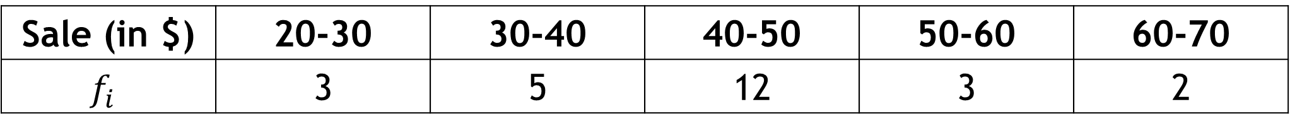
Mean Deviation
Sale (in $) | 20-30 | 30-40 | 40-50 | 50-60 | 60-70
$$f_{i}$$ | 3 | 5 | 12 | 3 | 2
Calculate the mean deviation about mean. (Ans: 7.776)

Slide 23
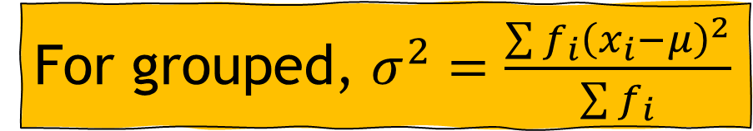



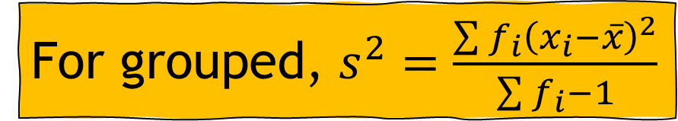
Variance
Let $x_{1},x_{2},…,x_{n}$ be $n$ observations
$σ^{2}=\frac{\sum{{\left(x_{i}−μ\right)}^{2}}}{N}$ [Population variance (ungrouped)]
$s^{2}=\frac{\sum{{\left(x_{i}−\overline{x}\right)}^{2}}}{n−1}$ [Sample variance (ungrouped)]
For grouped, $σ^{2}=\frac{\sum{{f_{i}\left(x_{i}−μ\right)}^{2}}}{\sum{f_{i}}}$
$$σ^{2}=\frac{\sum{x_{i}^{2}−\frac{{\left(\sum{x_{i}}\right)}^{2}}{N}}}{N}$$
$$s^{2}=\frac{\sum{x_{i}^{2}−\frac{{\left(\sum{x_{i}}\right)}^{2}}{n}}}{n−1}$$
For grouped, $s^{2}=\frac{\sum{{f_{i}\left(x_{i}−\overline{x}\right)}^{2}}}{\sum{f_{i}}−1}$

Slide 24
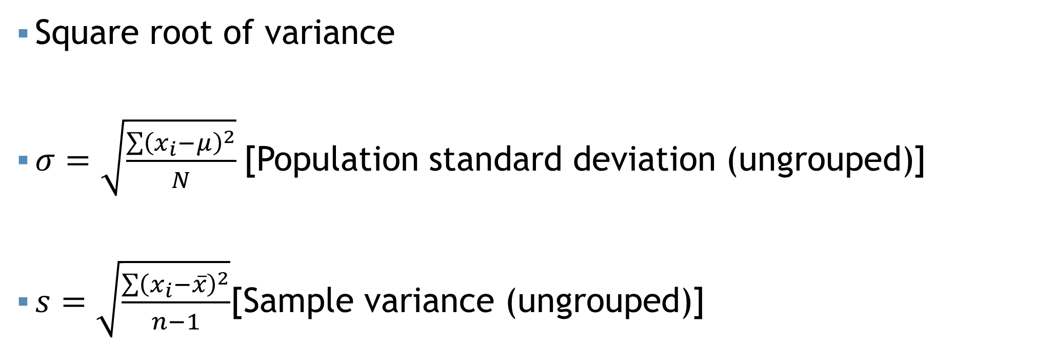
Standard Deviation
Square root of variance
$σ=\sqrt{\frac{\sum{{\left(x_{i}−μ\right)}^{2}}}{N}}$[Population standard deviation (ungrouped)]
$s=\sqrt{\frac{\sum{{\left(x_{i}−\overline{x}\right)}^{2}}}{n−1}}$[Sample variance (ungrouped)]

Slide 25
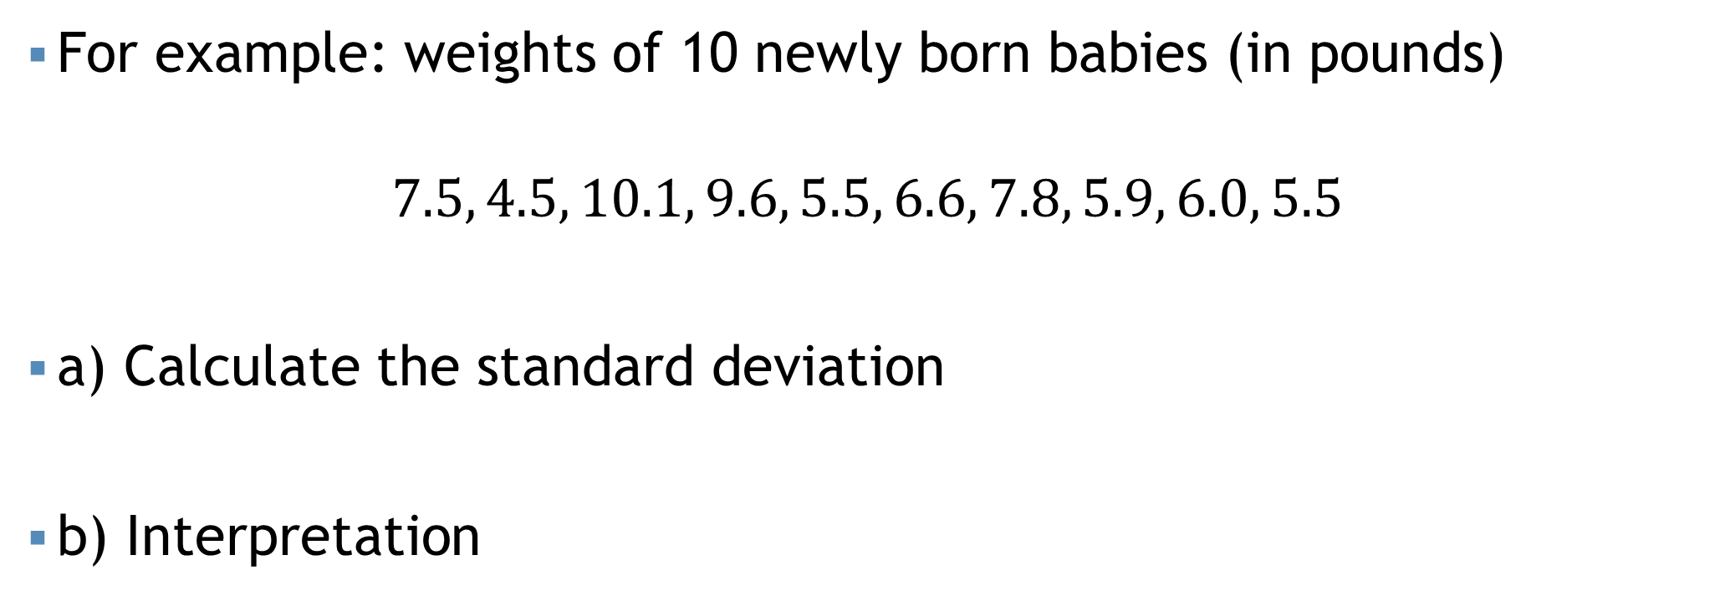
Standard Deviation
For example: weights of 10 newly born babies (in pounds)
$$7.5, 4.5, 10.1, 9.6, 5.5, 6.6, 7.8, 5.9, 6.0, 5.5$$
a) Calculate the standard deviation
b) Interpretation

Slide 26
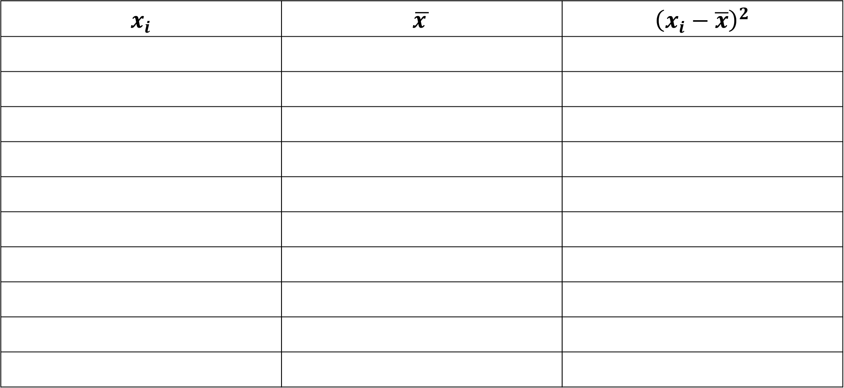
Standard Deviation
$$x_{i}$$ | $$\overline{x }$$ | $${\left(x_{i}−\overline{x}\right)}^{2}$$

Slide 27
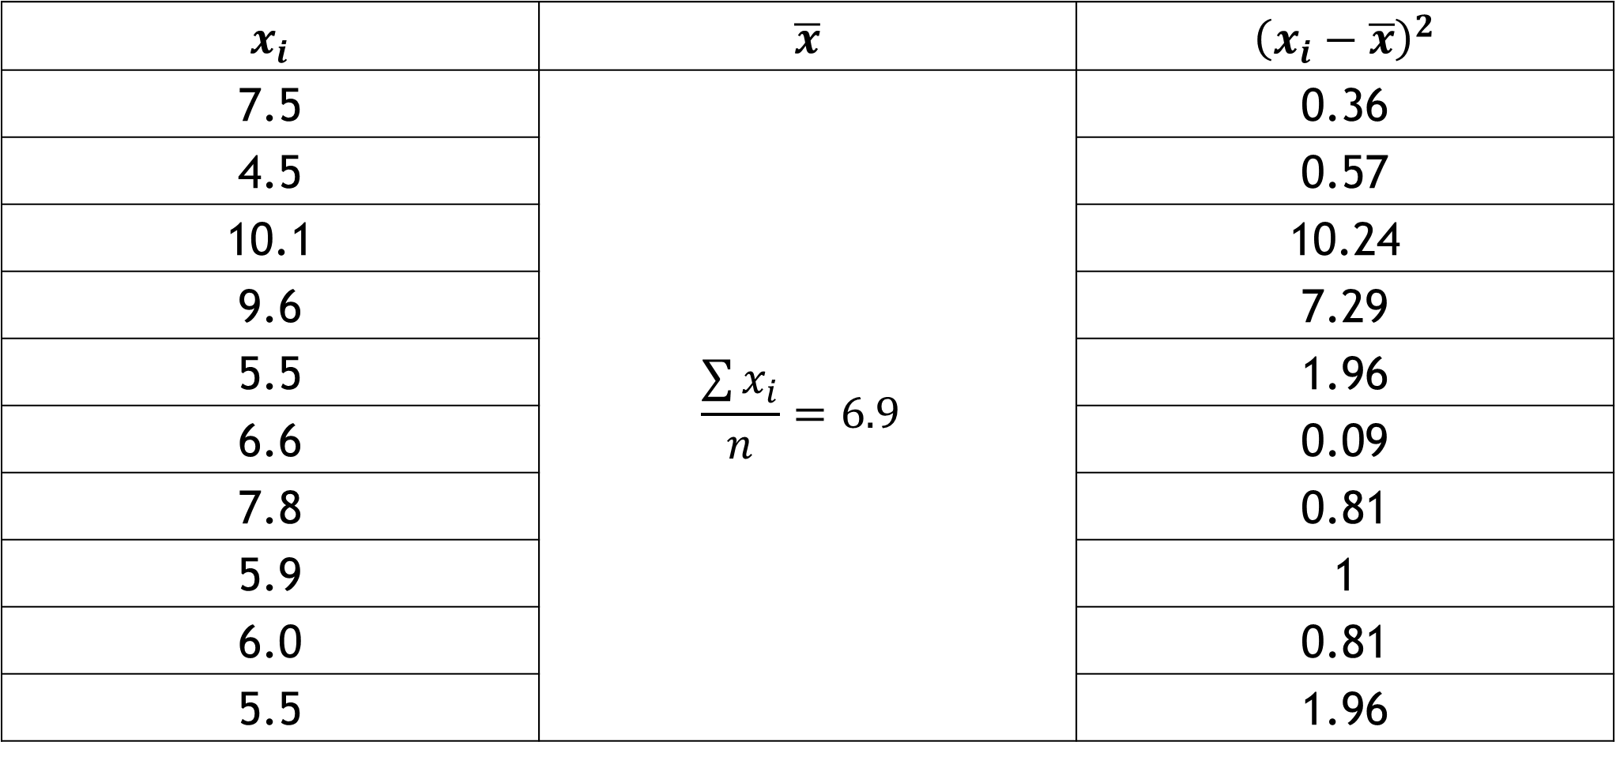
Standard Deviation
$$x_{i}$$ | $$\overline{x}$$ | $${\left(x_{i}−\overline{x}\right)}^{2}$$
7.5 | $$\frac{\sum{x_{i}}}{n}=6.9$$ | 0.36
4.5 |  | 0.57
10.1 |  | 10.24
9.6 |  | 7.29
5.5 |  | 1.96
6.6 |  | 0.09
7.8 |  | 0.81
5.9 |  | 1
6.0 |  | 0.81
5.5 |  | 1.96

Slide 28
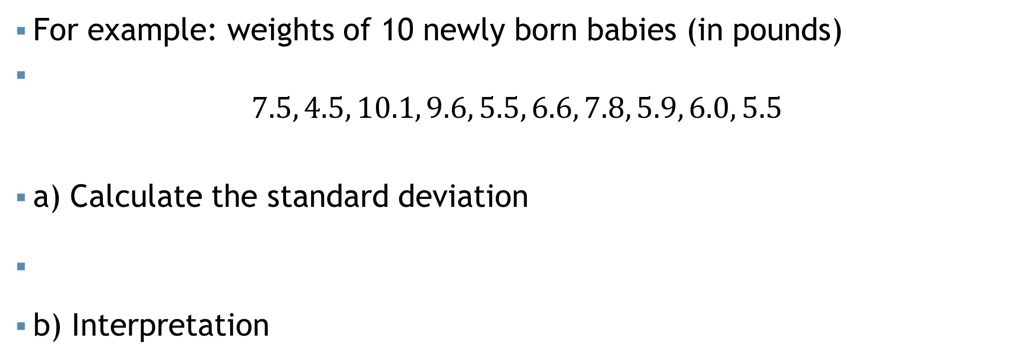
Standard Deviation
For example: weights of 10 newly born babies (in pounds)
$$7.5, 4.5, 10.1, 9.6, 5.5, 6.6, 7.8, 5.9, 6.0, 5.5$$
a) Calculate the standard deviation
$s=\sqrt{\frac{\sum{{\left(x_{i}−\overline{x}\right)}^{2}}}{n−1}}=\sqrt{\frac{30.28}{10−1}}=\sqrt{3.36}=1.83 pounds$
b) Interpretation

Slide 29
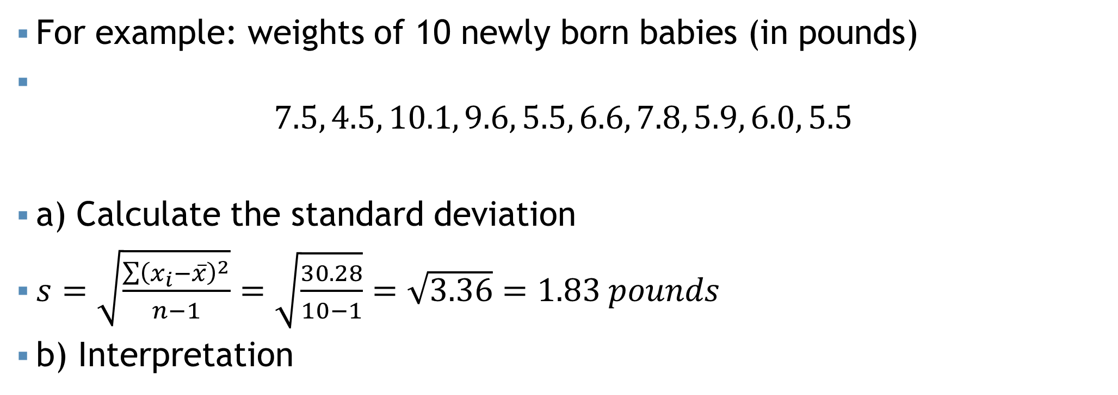
Standard Deviation
For example: weights of 10 newly born babies (in pounds)
$$7.5, 4.5, 10.1, 9.6, 5.5, 6.6, 7.8, 5.9, 6.0, 5.5$$
a) Calculate the standard deviation
$s=\sqrt{\frac{\sum{{\left(x_{i}−\overline{x}\right)}^{2}}}{n−1}}=\sqrt{\frac{30.28}{10−1}}=\sqrt{3.36}=1.83 pounds$
b) Interpretation
The average variation of the weights of the newly born babies from the mean weights is 3.36 pounds. The standard deviation is 1.83 pounds.

Slide 30
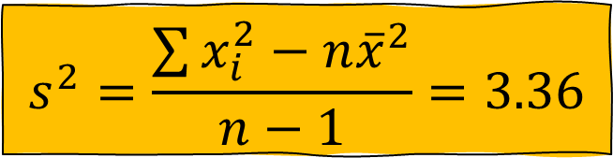
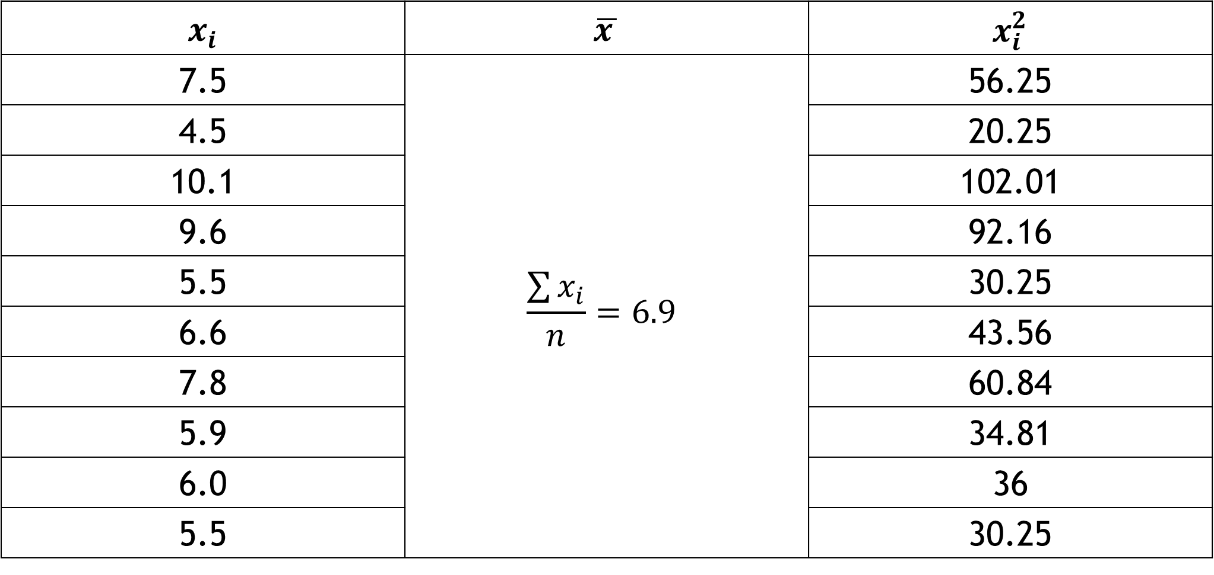
Standard Deviation (Alternative)
$$s^{2}=\frac{\sum{x_{i}^{2}−n{\overline{x}}^{2}}}{n−1}=3.36$$
$$x_{i}$$ | $$\overline{x }$$ | $$x_{i}^{2}$$
7.5 | $$\frac{\sum{x_{i}}}{n}=6.9$$ | 56.25
4.5 |  | 20.25
10.1 |  | 102.01
9.6 |  | 92.16
5.5 |  | 30.25
6.6 |  | 43.56
7.8 |  | 60.84
5.9 |  | 34.81
6.0 |  | 36
5.5 |  | 30.25

Slide 31
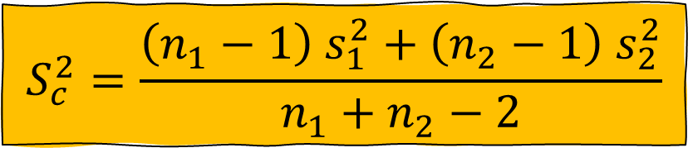
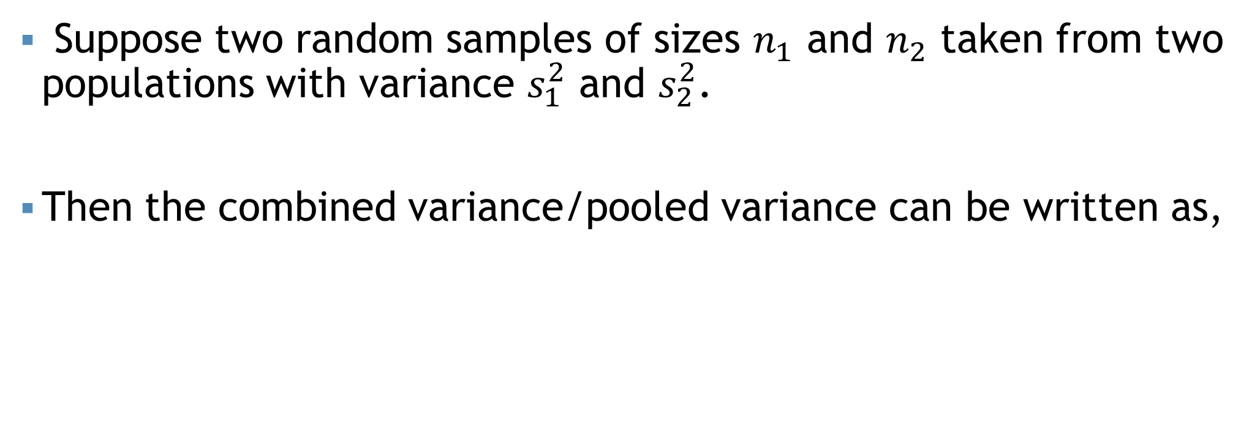
Combined variance
Suppose two random samples of sizes $n_{1}$ and $n_{2}$ taken from two populations with variance $s_{1}^{2}$ and $s_{2}^{2}$.
Then the combined variance/pooled variance can be written as,
$$S_{c}^{2}=\frac{\left(n_{1}−1\right) s_{1}^{2}+\left(n_{2}−1\right) s_{2}^{2}}{n_{1}+n_{2}−2}$$

Slide 32
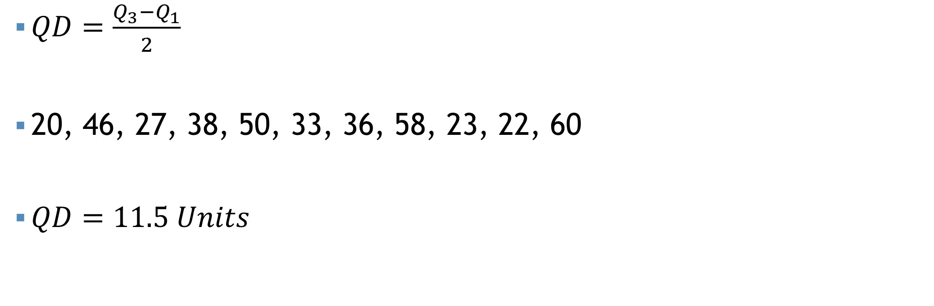
Quartile deviation
$QD=\frac{Q_{3}−Q_{1}}{2}$
20, 46, 27, 38, 50, 33, 36, 58, 23, 22, 60
$QD=11.5 Units$

Slide 33
Relative measures
To compare the variation of two or more data sets having different or same units

Slide 34

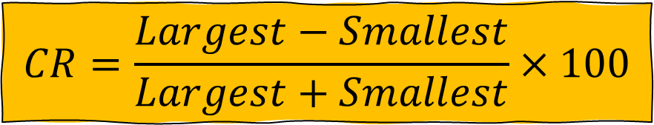

Relative measures
To compare the variation of two or more data sets having different or same units
Coefficient of Range
Coefficient of MD
Coefficient of variance
Coefficient of QD
$$CR=\frac{Largest−Smallest}{Largest+Smallest}×100$$
$$CMD=\frac{MD (\overline{x})}{\overline{x}}×100$$
$$CQD=\frac{Q_{3}−Q_{1}}{Q_{3}+Q_{1}}×100$$

Slide 35
Relative measures
To compare the variation of two or more data sets having different or same units
Coefficient of Range
Coefficient of MD
Coefficient of variance
Coefficient of QD

Slide 36

Coefficient of variance (CV)
It is a ratio
Between standard deviation (SD) and mean
Expressed as percent
$$General formula of CV=\frac{SD}{mean}×100$$

Slide 37
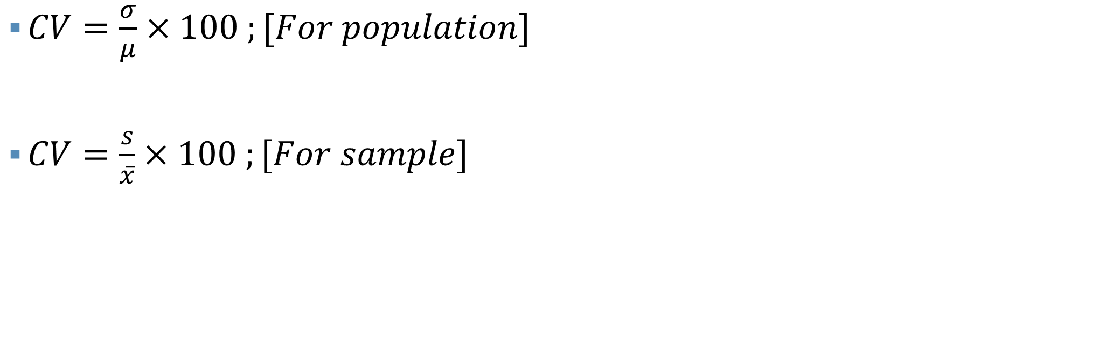
Coefficient of variance (CV)
Higher CV = High variation
Lower CV = Low Variation
$CV=\frac{σ}{μ}×100 ;[For population]$
$CV=\frac{s}{\overline{x}}×100 ;[For sample]$
More consistent
More uniform
More stable
More homogeneous

Slide 38
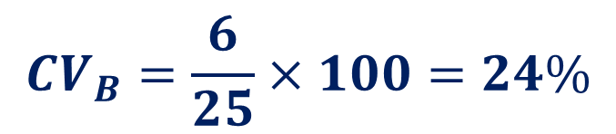
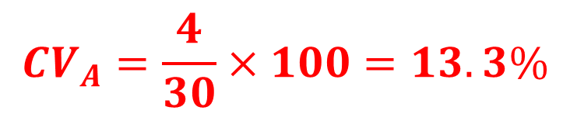
Coefficient of variance (CV)
$$CV_{A}=\frac{4}{30}×100=13.3\%$$
Section A: Mean = 30 and SD = 4
Section B: Mean = 25 and SD = 6
Which section is more consistent in getting final exam mark?
$$CV_{B}=\frac{6}{25}×100=24\%$$
Since, the CV of A is lower than the CV of B.
Thus, section A is more consistent comparatively section B

Slide 39
Coefficient of variance (CV)
Life (years) | 0-2 | 2-4 | 4-6 | 6-8 | 8-10
IBM | 5 | 13 | 20 | 7 | 5
ASUS | 2 | 7 | 12 | 20 | 9
a) Which model provides higher average lifetime?
Ans: ASUS
b) Which model has the greater variation in lifetime?
Ans: IBM
c) Which model do you prefer and why?
Ans: ASUS

Slide 40
Thank You

